Slide 1

CropCare AI THE SMART FARMING REVOLUTION - EMB 32
Project Member Details:
Gowthaman S P (RA20114010068) Ramkumar M V (RA20114010079)
Mirudula Shri M (RA20114010095)
Project Guide:
Under the guidance of
Dr. Subhashini J
Associate Professor, Department of ECE

Slide 2
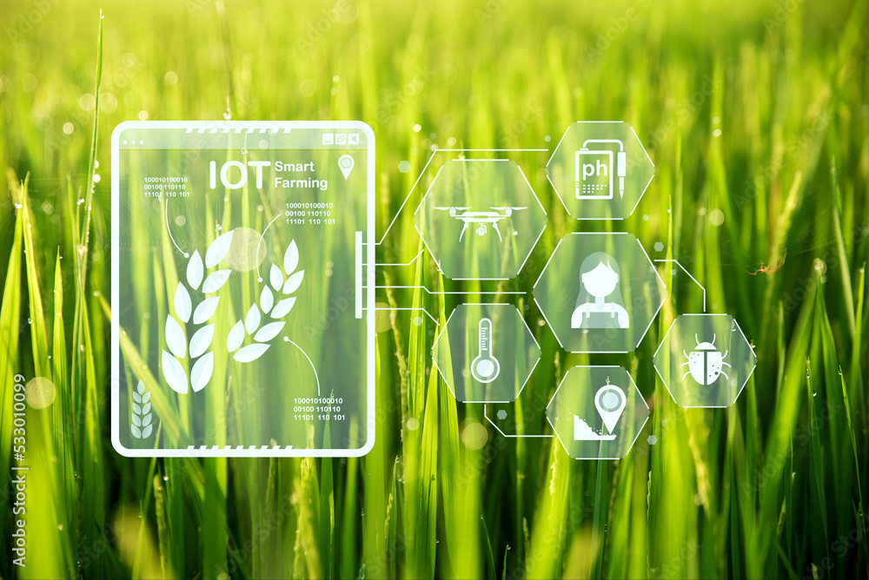
Introduction
A smart farming system which employs IoT devices to simultaneously gather real-time data on soil and weather conditions. Integrating machine learning algorithms, a mobile application provides insights and recommendations for optimized inputs, enhancing the overall efficiency and productivity of paddy cultivation.
Fig1. Agriculture Technology and Smart Farming
Source: Adobe stock image

Slide 3
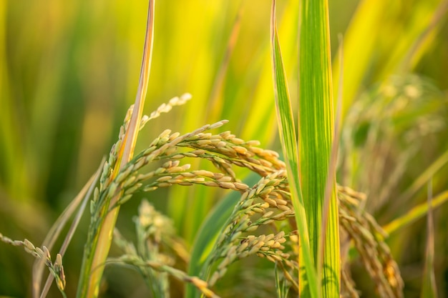
Motivation & Objectives of the work
Make people practice agriculture.
To help the food shortage in the upcoming years.
Practicing agriculture in a healthy way that enhances soil structure and reduces soil erosion.
Fig 2. healthy paddy crop
Source:Ministry of Agriculture & Farmers Welfare,Government of India

Slide 4
Literature Review
TITLE | PUBLICATION INFO | INFERENCE | NOVELTY
Towards Paddy Rice Smart Farming: A Review on Big Data, Machine Learning, and Rice Production Task[1] | R. Alfred, J. H. Obit, C. P. -Y. Chin, H. Haviluddin and Y. Lim, "Towards Paddy Rice Smart Farming: A Review on Big Data, Machine Learning, and Rice Production Tasks," in IEEE Access, vol. 9, pp. 50358-50380, 2021, doi: 10.1109/ACCESS.2021.3069449. | The paper uses a combination of machine learning and big data in smart farming to enhance paddy’s efficiency and sustainability. | Real-time monitoring system through a mobile application and recommendations based on the requirements.
Smart paddy field monitoring system using deep learning and IoT [2] | Sethy, Prabira Kumar, Santi Kumari Behera, Nithiyakanthan Kannan, Sridevi Narayanan, and Chanki Pandey. "Smart paddy field monitoring system using deep learning and IoT." Concurrent Engineering 29, no. 1 (2021): 16-24. | Disease detection in crops and soil was examined. Recommendations of fertilizers and pesticides were made. Predictions are done based on ML algorithms. | Monitors and recommends the required input for the paddy crop using ML using the values obtained through different sensors.
An IoT-based intelligent farming using CNN for early disease detection in rice paddy[3] | Debnath, Oliva, and Himadri Nath Saha. "An IoT-based intelligent farming using CNN for early disease detection in rice paddy." Microprocessors and Microsystems 94 (2022): 104631. | Detects brown spot disease in paddy rice and uses ML algorithms to detect them. Mobile application was developed to monitor the data. | Suggest better manures and pesticides to enhance the yield and improve the quality of crop. Mobile application has been developed to learn paddy agriculture and analyze the crop.

Slide 5
Literature Review
TITLE | PUBLICATION INFO | INFERENCE | NOVELTY
IoT Framework for Measurement and Precision Agriculture: Predicting the Crop Using Machine Learning Algorithms[4] | Bakthavatchalam, Kalaiselvi, Balaguru Karthik, Vijayan Thiruvengadam, Sriram Muthal, Deepa Jose, Ketan Kotecha, and Vijayakumar Varadarajan. "IoT framework for measurement and precision agriculture: predicting the crop using machine learning algorithms." Technologies 10, no. 1 (2022): 13. | IoT framework integrates sensors, ML for precise agriculture, improving accuracy, optimizing resources, predicting crop outcomes. | Real-time analysis and predictions are done. Recommendation based on ML algorithm. User-friendly mobile application.
Exploration of machine learning approaches for paddy yield prediction in eastern part of Tamilnadu[5] | Joshua, Vinson, Selwin Mich Priyadharson, and Raju Kannadasan. "Exploration of machine learning approaches for paddy yield prediction in eastern part of Tamilnadu." Agronomy 11, no. 10 (2021): 2068. | The paper applies machine learning for Utilizing ML, predicts paddy yield in Eastern Tamil Nadu, highlighting algorithmic effectiveness and regional specificity. | Universal applicability; our project adapts over 6 months, tailoring to specific soil and weather conditions.
A Revisit of Internet of Things Technologies for Monitoring and Control Strategies in Smart Agriculture[6] | Rehman, Amjad, Tanzila Saba, Muhammad Kashif, Suliman Mohamed Fati, Saeed Ali Bahaj, and Huma Chaudhry. "A revisit of internet of things technologies for monitoring and control strategies in smart agriculture." Agronomy 12, no. 1 (2022): 127. | This paper uses IoT technologies in smart agriculture, which monitors and control the plant growth. | Machine learning algorithm is used predict the values based on the values obtained using IoT sensors

Slide 6
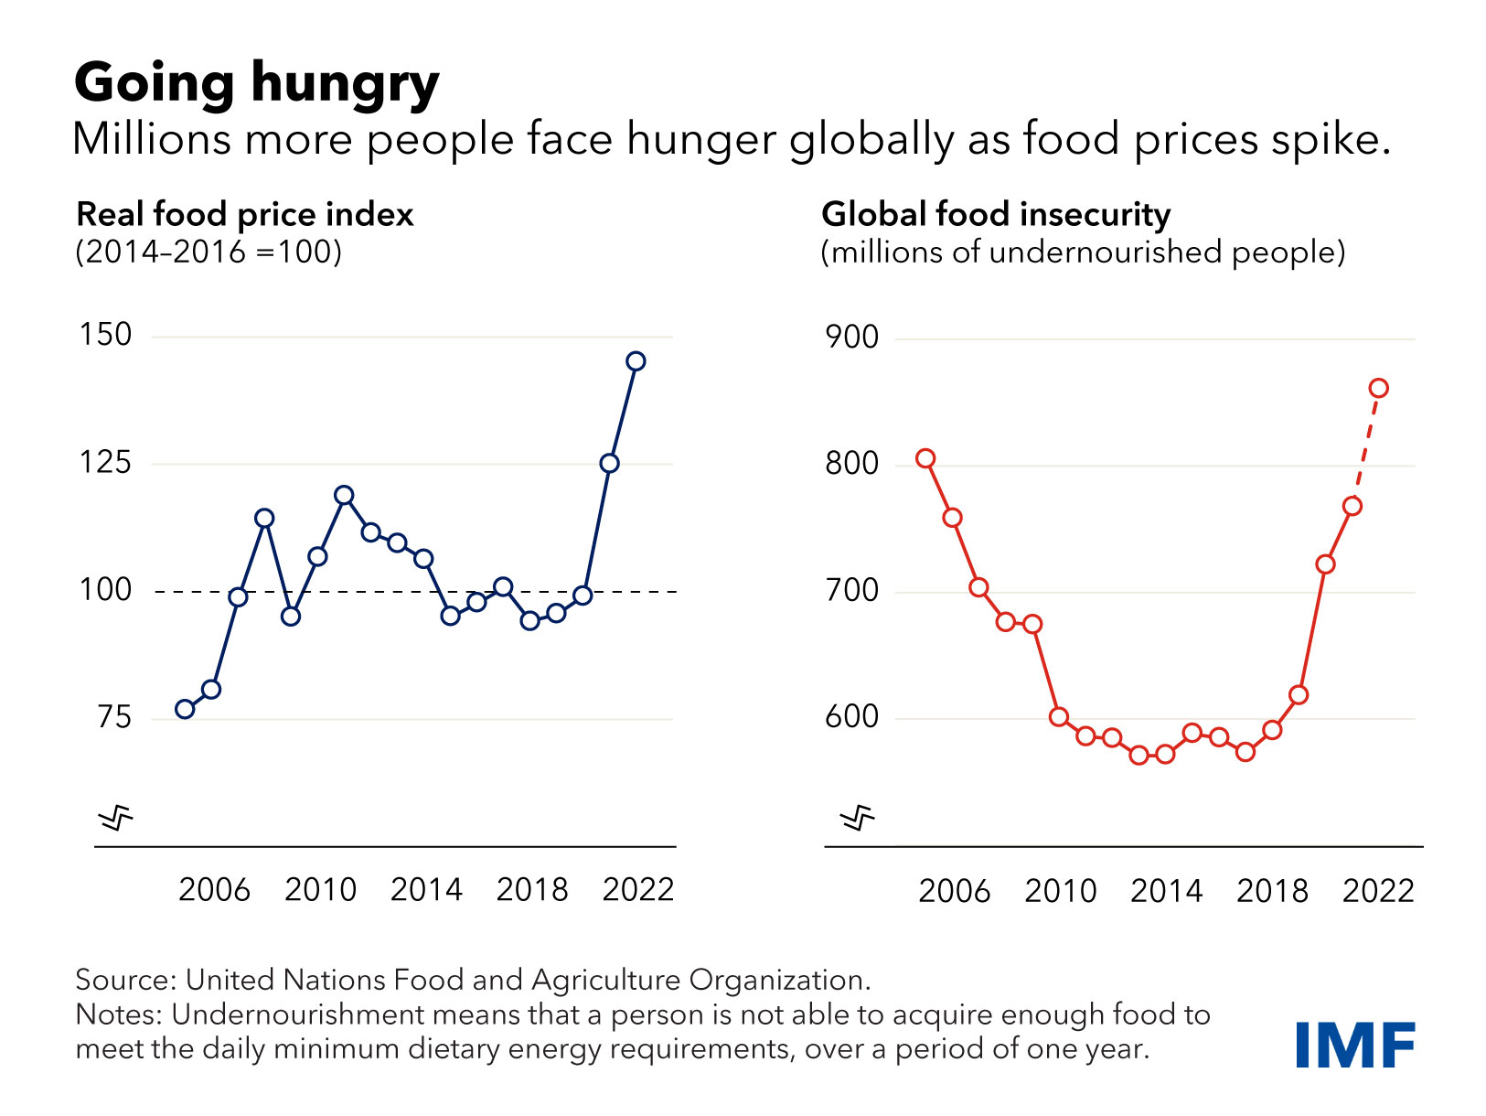
Problem Statement
Issue:
Millions of people are dying every year from due to lack of food.
Price of food has been increasing because the “demand is greater than supply”.
Solution:
Our project enables every individual to practice agriculture and aims to make them self-sufficient.
Fig 3. Stats of Real food price and Food insecurity
Source: IMF Blog

Slide 7
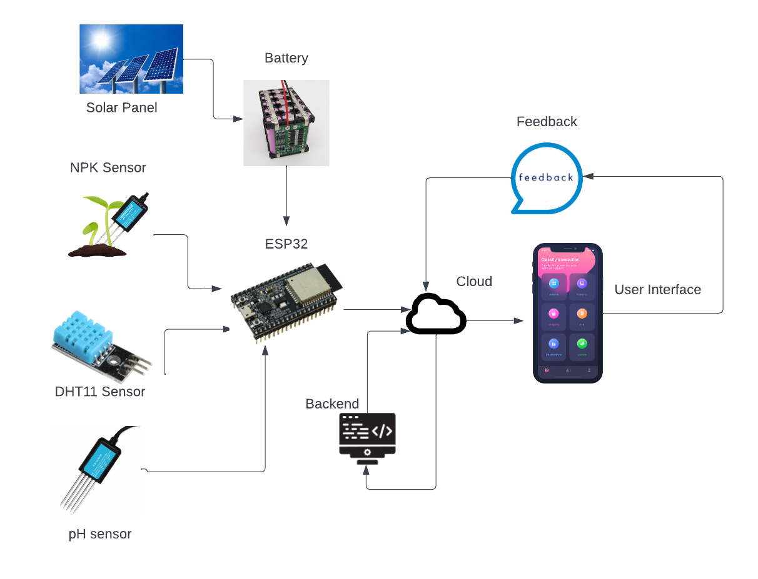
Block diagram
Fig.4 Block Diagram

Slide 8
Sensor specifications
Sensors | Operating Voltage | Maximum current supply | Response Time | Interface | Range | Output
NPK | 5V-30VDC | 4-20mA | <10 seconds | Serial | 0-300 ppm | Serial Data
pH | 5V-30VDC | Max 6mA | <10 seconds | Serial | 0- 14 pH | Serial Data
Rain Sensor | 5V DC | 2mA | <10 seconds | Serial | 0-256 | Serial Data

Slide 9
Crop requirements
Content | Rice | Wheat | Maize | Cotton
Nitrogen(kg/ha) | 120 | 80 | 120 | 50
Phosphorous(kg/ha) | 30 | 40 | 60 | 30
Potassium(kg/ha) | 30 | 40 | 40 | 35
Temperature (*C) | 29 | 23 | 28 | 27
Humidity (g/m3) | 80 | 55 | 60 | 70
pH | 6.5 | 6.5 | 6.5 | 7
Rainfall(Sensor val) | 250 | 150 | 200 | 150

Slide 10
Fertilizer requirements
Percentage of NPK in the fertilizers
Fertilizers | N | P | K
Urea | 46%
Di-ammonium phosphate | 18% | 46%
Muriate of potash |  |  | 60%

Slide 11
Fertilizer Calculation
STEP 1:
MOP= (X*100) / 60 kg/ha
STEP 2:
DAP= (Y*100) /46 kg/ha
STEP 3:
Amount of Nitrogen in DAP added
= (DAP*18) / 100
STEP 4:
(Optimal value of N- N value obtained from the sensor) -
(Amount of Nitrogen in DAP added)=M
STEP 5:
Urea= (M*100) / 46 kg/ha
X= Optimal value of K -
K Value obtained from sensor
Y= Optimal value of P-
P Value obtained from sensor

Slide 12
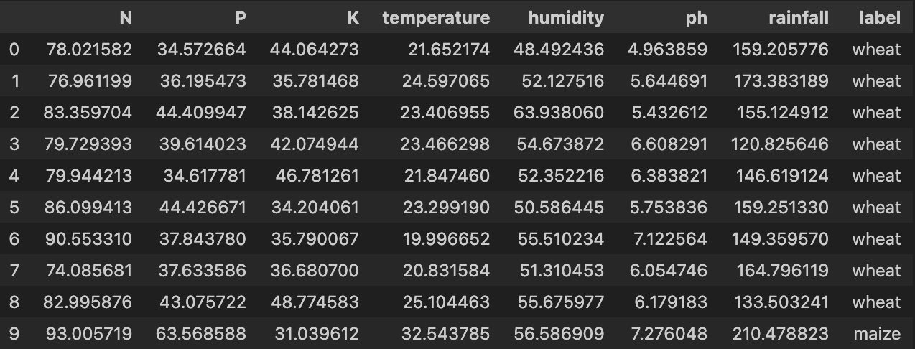
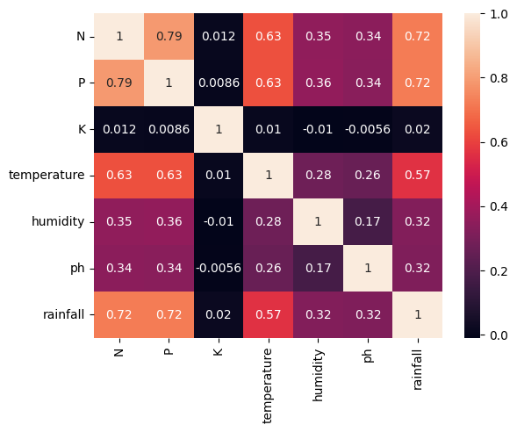
NPK Dataset - North
Fig 4. North-Dataset
Selected crops: Wheat, Maize
Dataset size: 48000(6000*8)
Fig 5. Correlation matrix

Slide 13
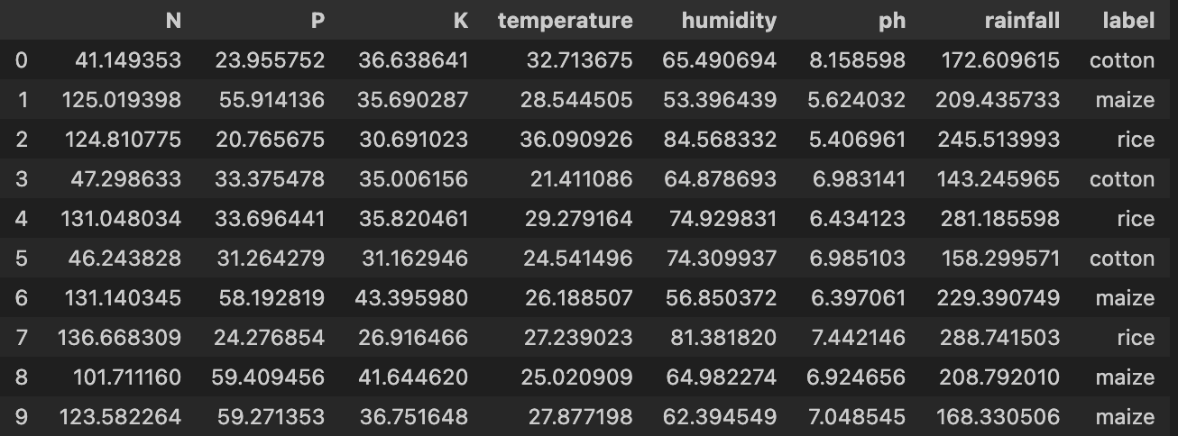
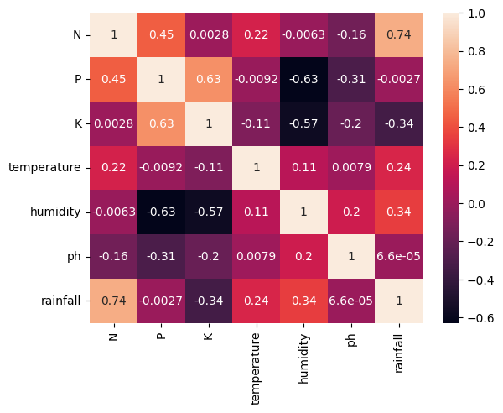
NPK Dataset - South
Fig 6. South-Dataset
Selected crops: Rice, Maize, Cotton
Dataset size: 72000(9000*8)
Fig 7. Correlation matrix

Slide 14
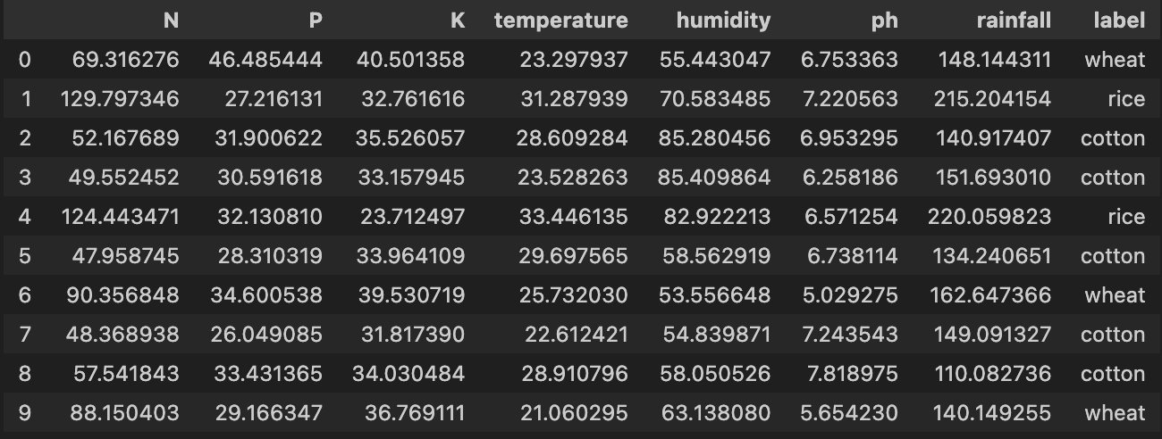
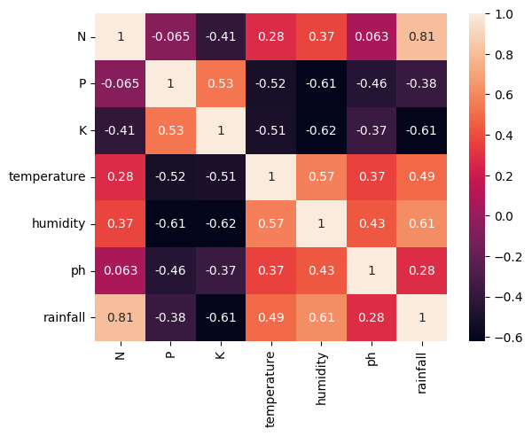
NPK Dataset - West
Fig 8. West-Dataset
Selected crops: Wheat, Rice,Cotton
Dataset size: 72000(9000*8)
Fig 9. Correlation matrix

Slide 15
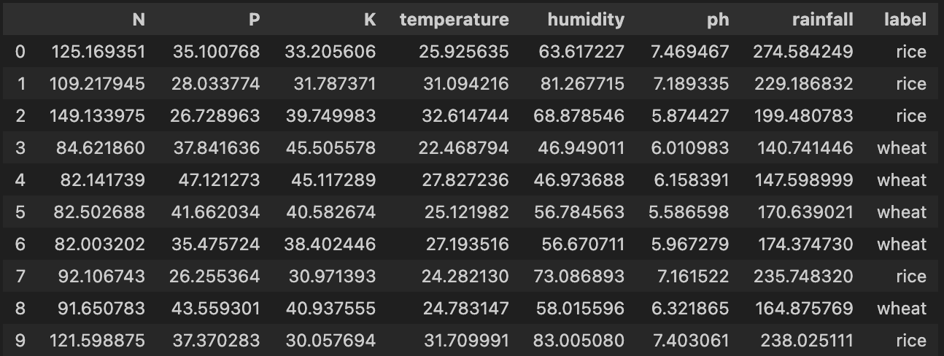
NPK Dataset - East
Fig 10. East-Dataset
Selected crops: Wheat, Rice
Dataset size: 48000(6000*8)
Fig 11. Correlation matrix

Slide 16
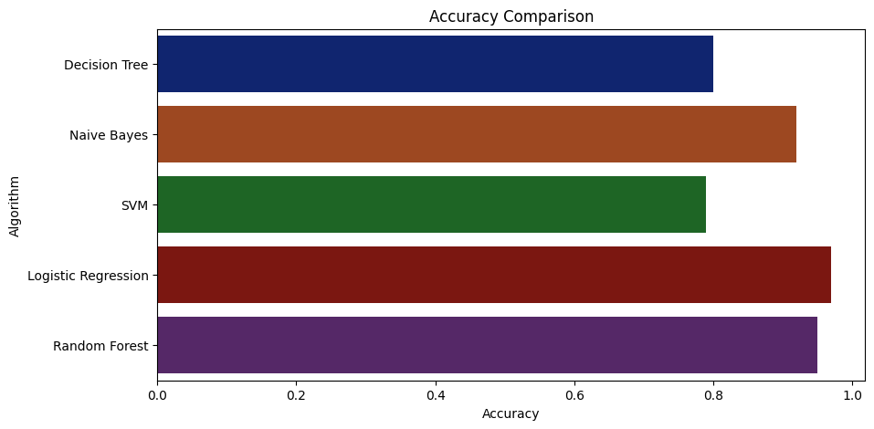
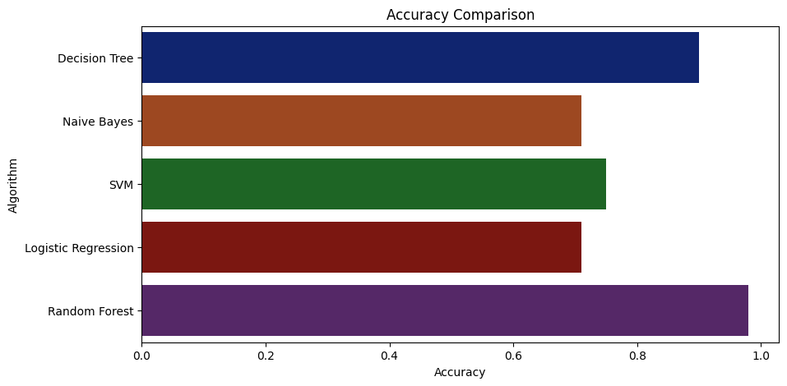
Performance metrics of the models(North/South)
Metrics | Precision | Recall | f1-score
Cotton | 1.00 | 0.97 | 0.97
Rice | 0.99 | 1.00 | 1.00
Maize | 0.99 | 0.98 | 0.98
Accuracy |  |  | 0.98
Metrics | Precision | Recall | f1-score
Maize | 0.92 | 0.94 | 0.96
Wheat | 0.96 | 0.95 | 0.98
Accuracy |  |  | 0.97
Fig. 12 Performance metrics - north
Fig. 13 Performance metrics - south

Slide 17
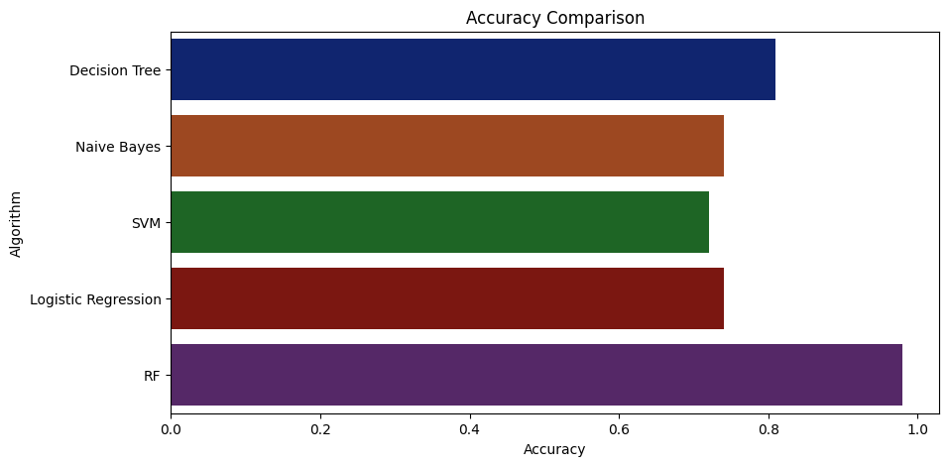
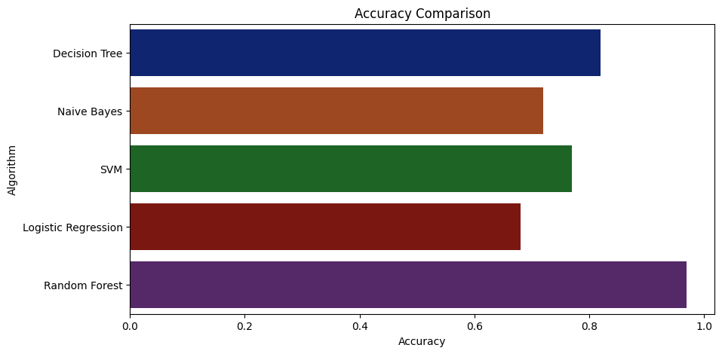
Performance metrics of the models(West/East)
Metrics | Precision | Recall | f1-score
Rice | 1.00 | 0.95 | 0.96
Wheat | 0.99 | 1.00 | 1.00
Cotton | 0.99 | 0.96 | 0.97
Accuracy |  |  | 0.97
Metrics | Precision | Recall | f1-score
Rice | 0.99 | 1.00 | 1.00
Wheat | 0.99 | 0.98 | 0.97
Accuracy |  |  | 0.98
Fig. 14 Performance metrics - east
Fig. 15 Performance metrics - west

Slide 18
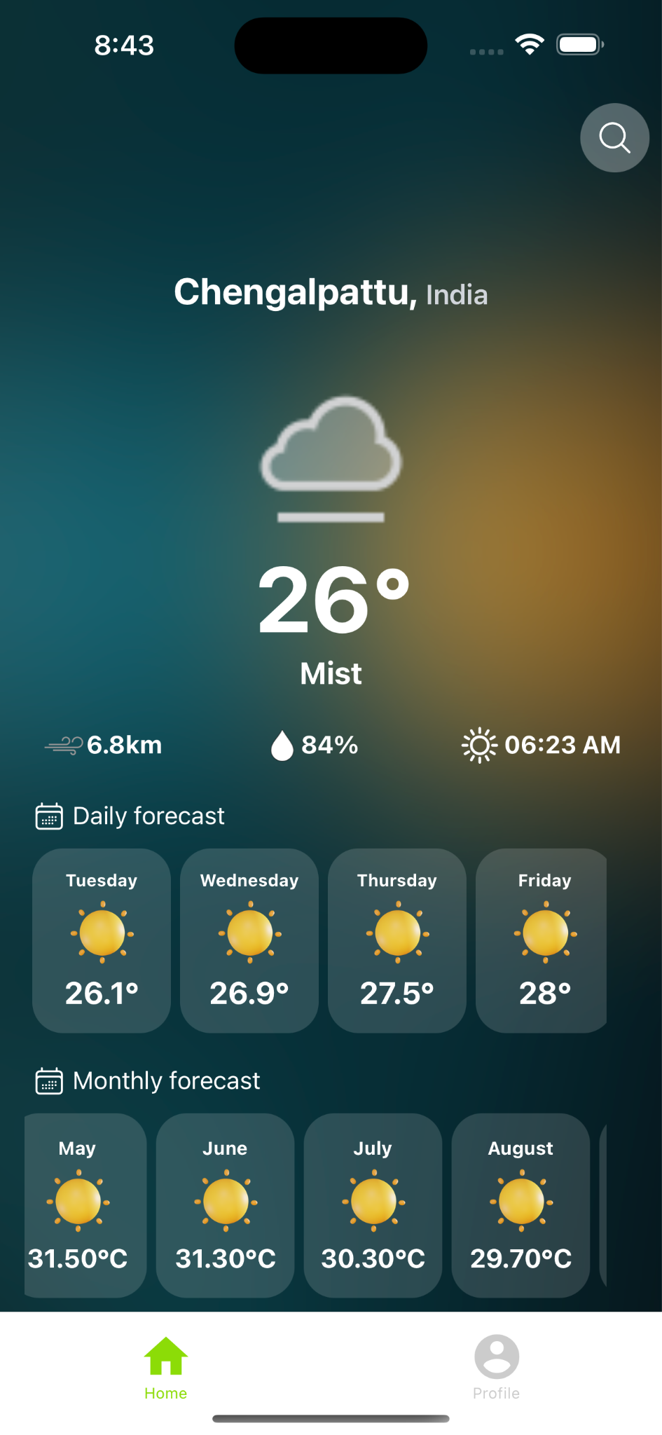
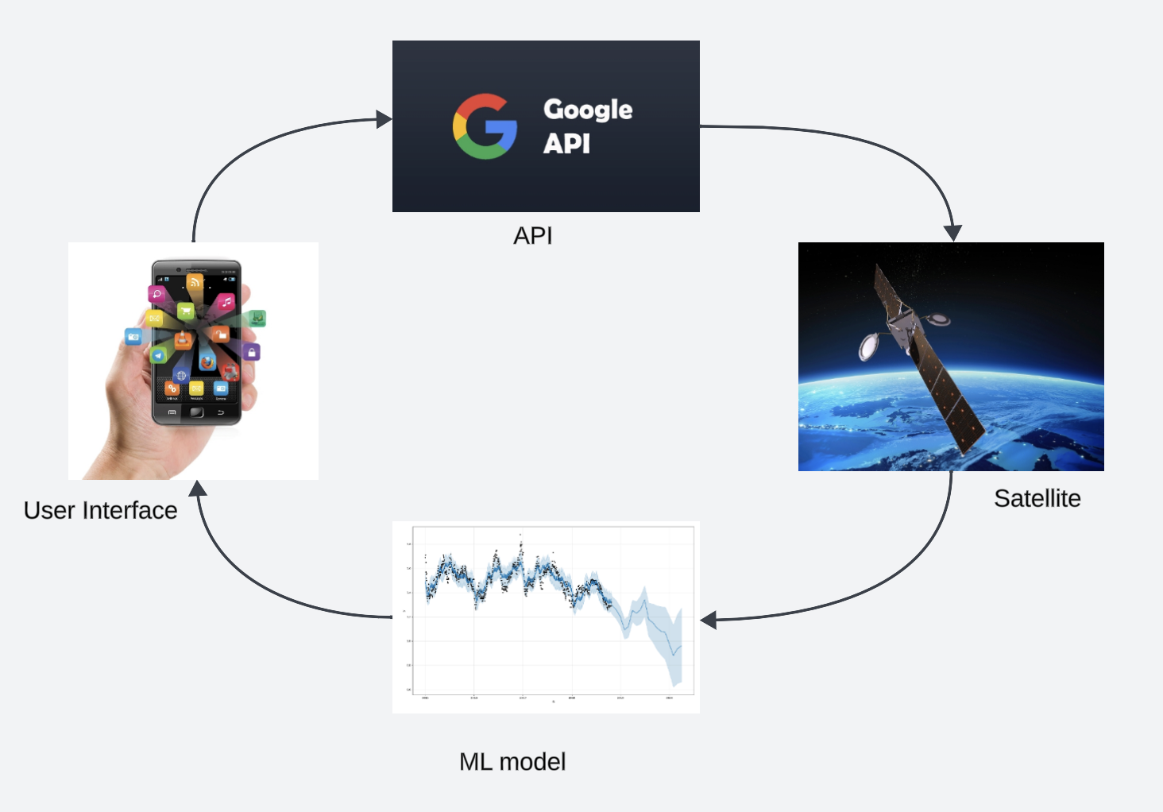
Weather API
The weather API takes the data from Google Weather, the data are Temperature, Humidity, Wind Speed and Forecast for forthcoming months
Fig 16. API working
Fig 17. Weather Screen

Slide 19
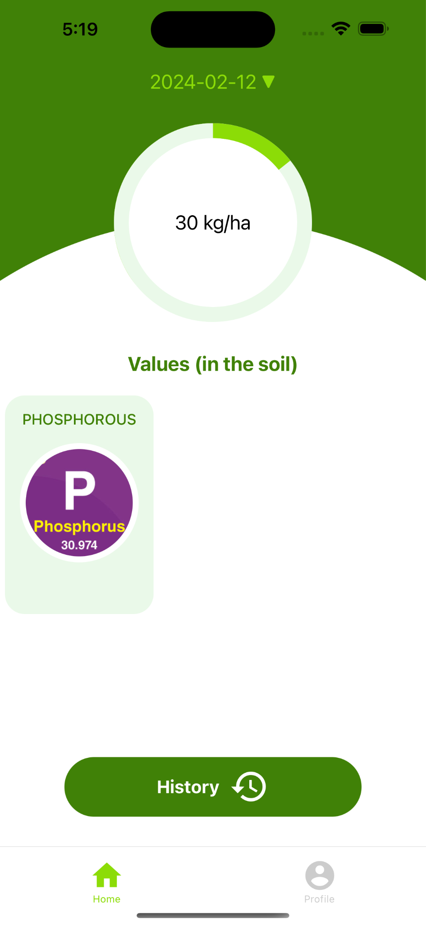
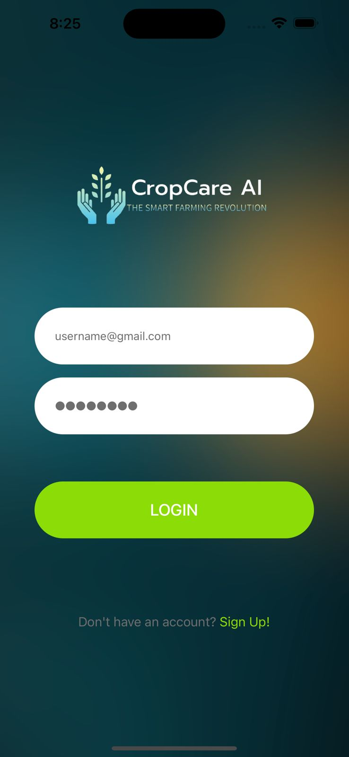
Front-end(Mobile application)
This is the Login Page, which uses firebase authentication. We have also set the Sign up link for the new users, where they can create their new account and login.
Fig 18.Login Page

Slide 20
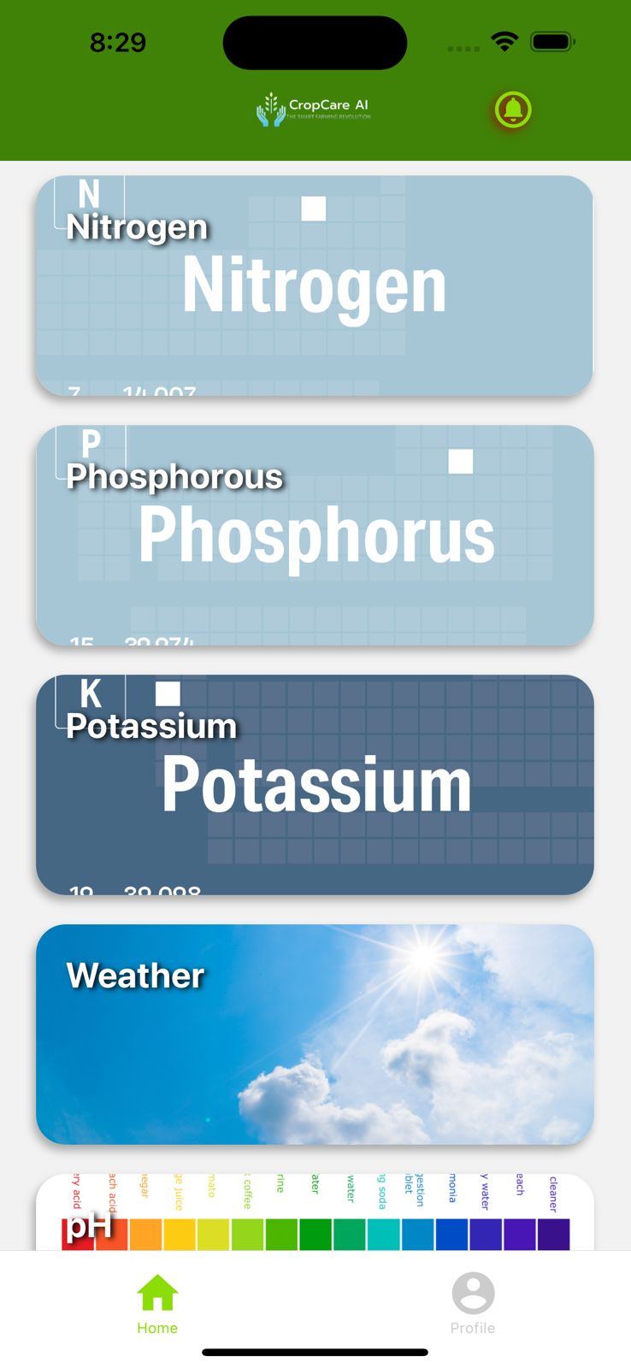
Front-end(Mobile application)
This is the Home Page, which uses firebase database.We have all the home icons to go into new pages. They can retrieve the data from database to see the recommendations. After stage process when we have all the data predicted.
Fig 19.Home Page

Slide 21
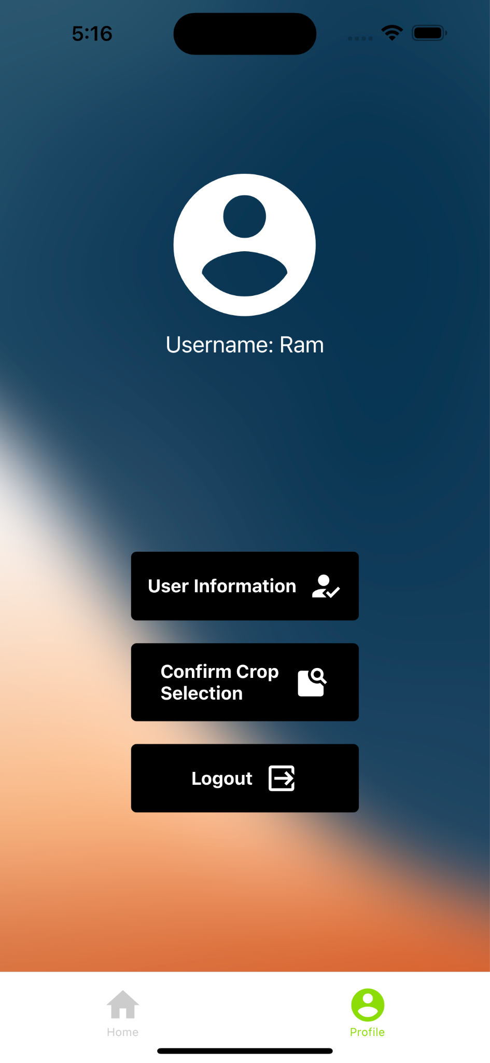
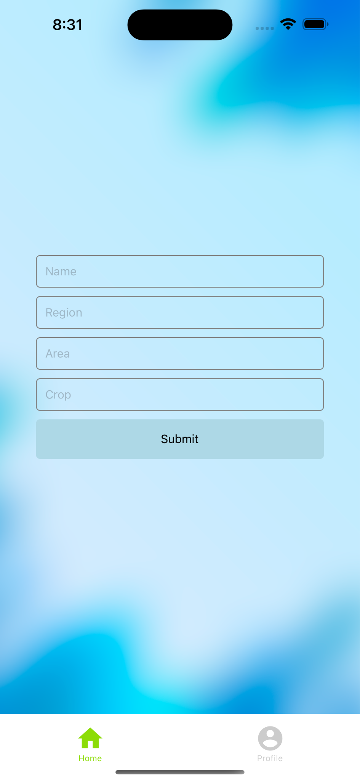
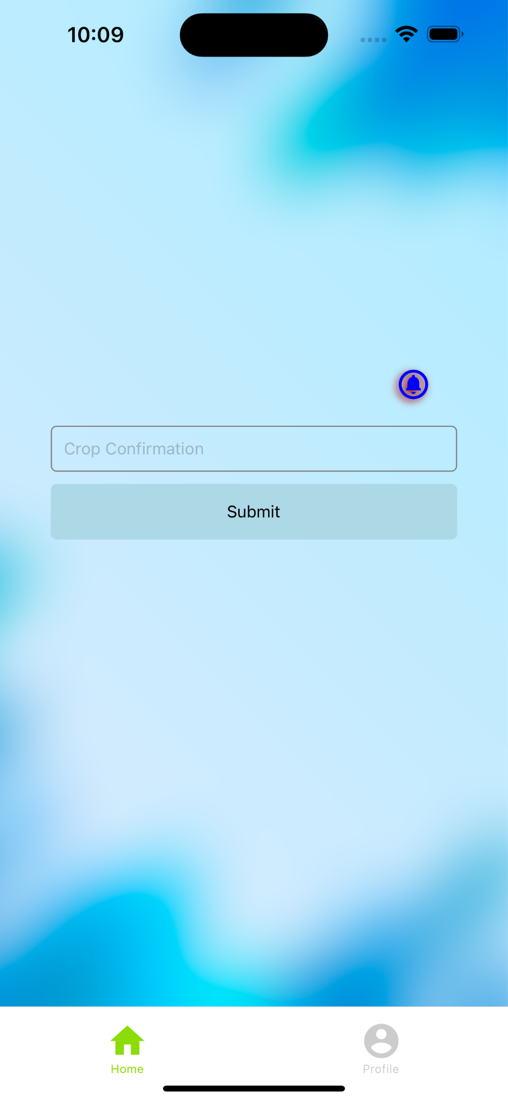
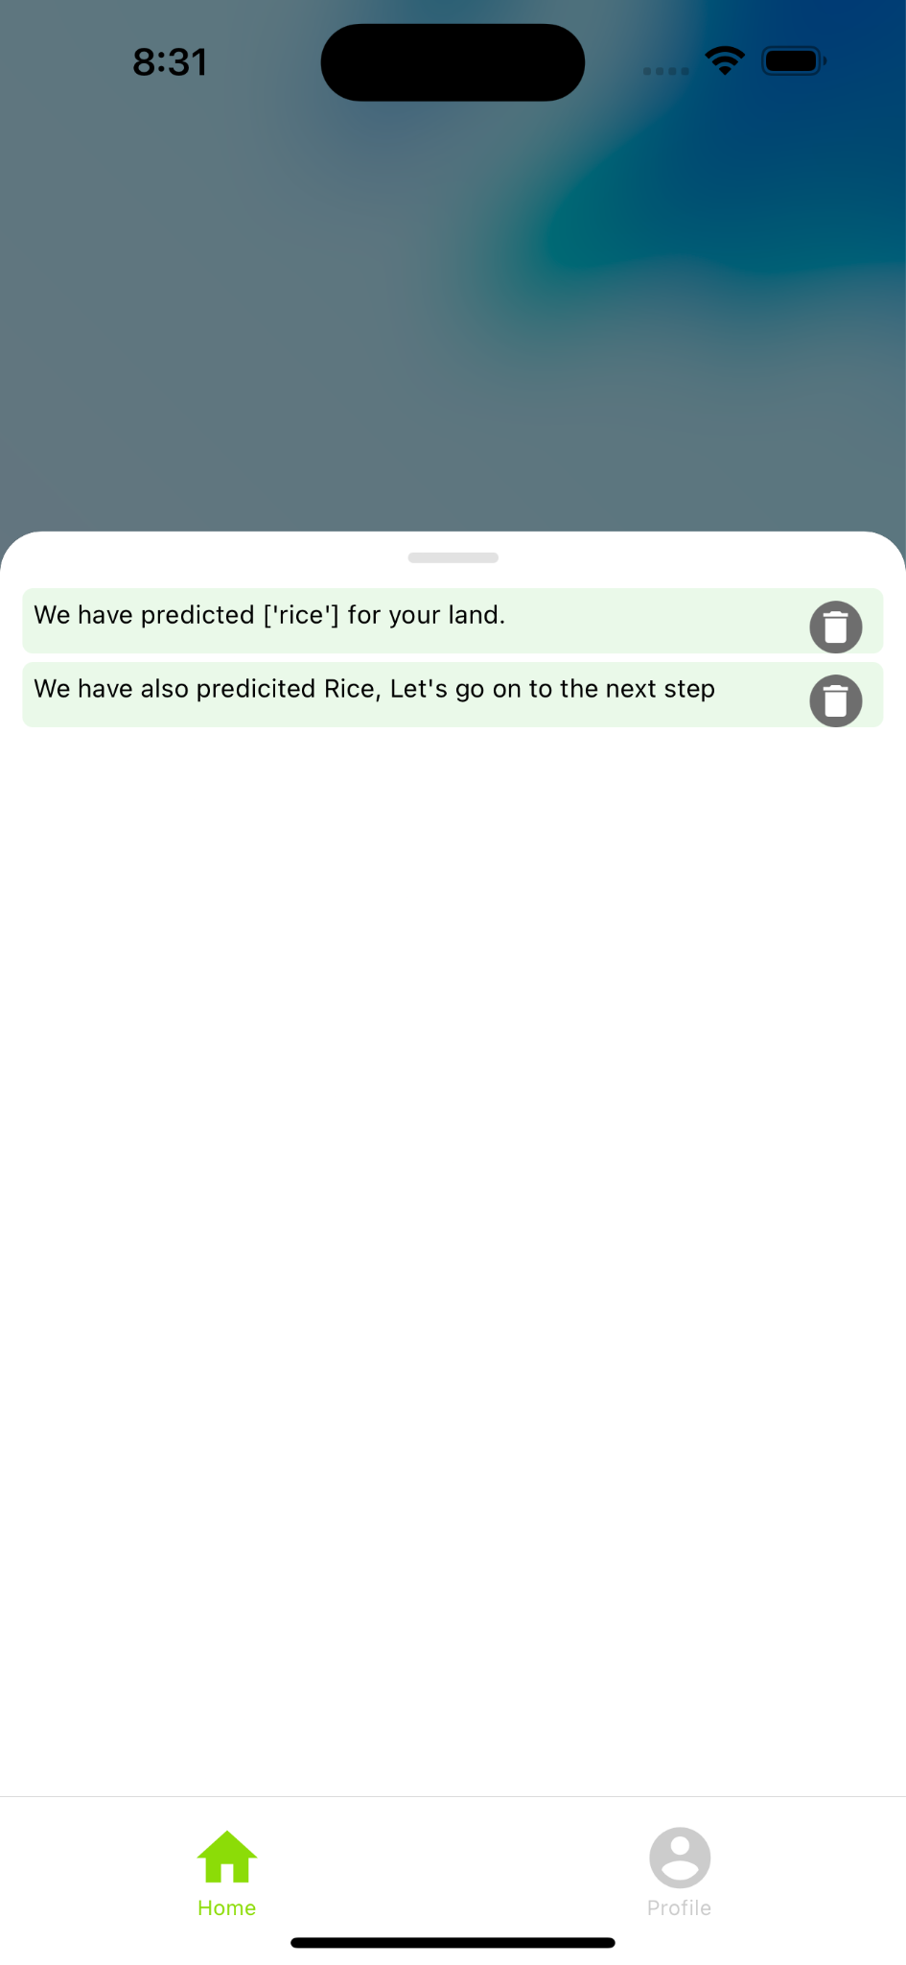
Front-end(Mobile application)
Fig 21. User Page
Fig 20. Profile Page
This is the Profile Page, which uses firebase database and Firebase Signout. The user can log out from this page and here we have also set the User information and Crop confirmation from here.

Slide 22
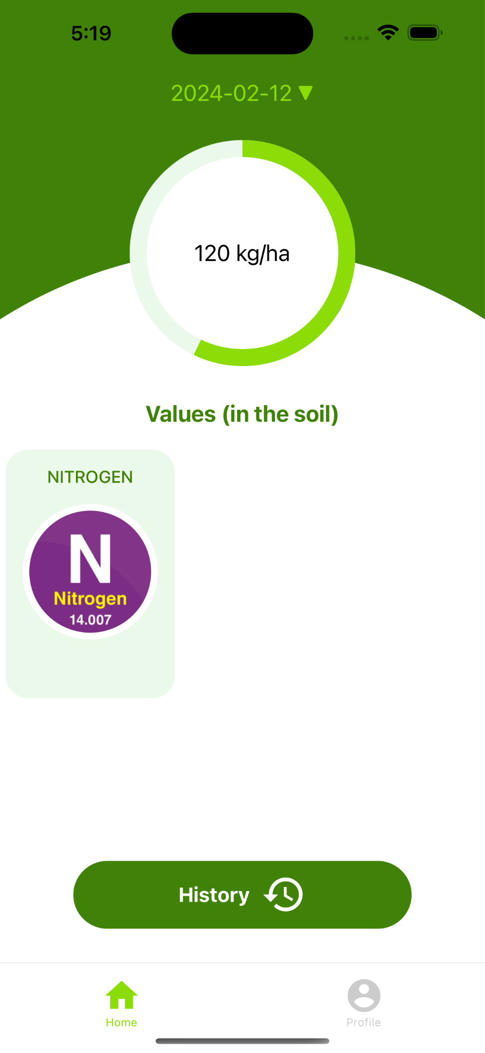
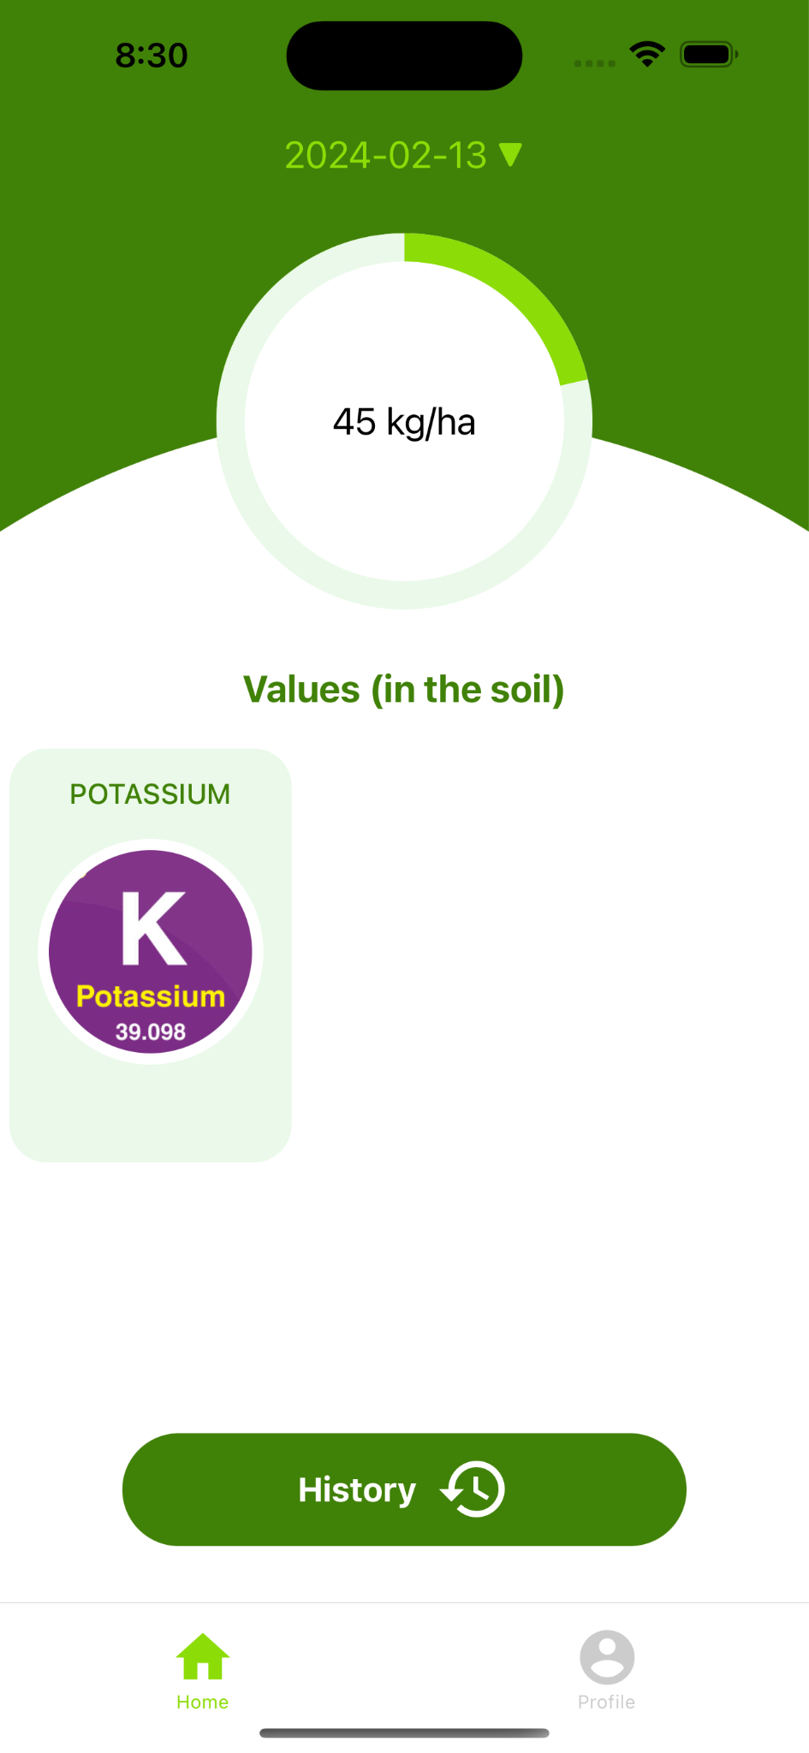
Front-end(Mobile application)
This is the NPK Page, which uses firebase database. It gets the data from the firebase database. All the NPK values gets updated from the sensor to the database and then they can view it here.
Fig 22. NPK Page

Slide 23
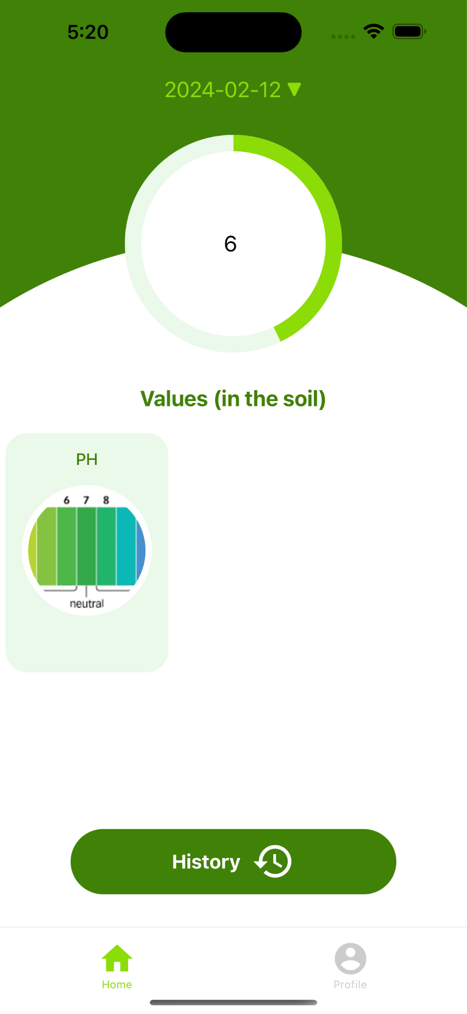
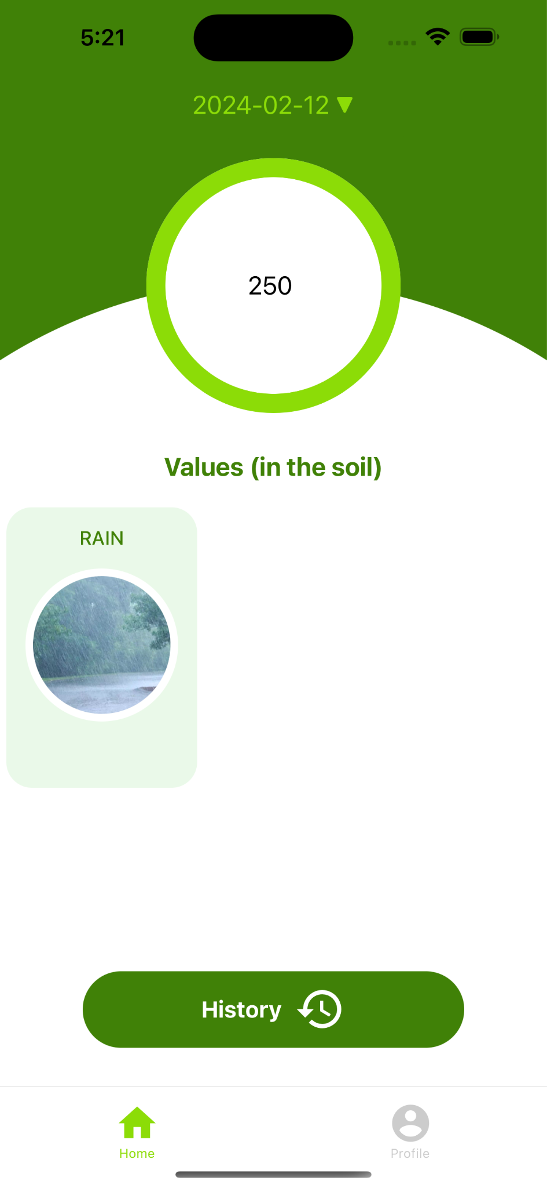
Front-end(Mobile application)
This is the Ph Page and Rain page, which uses firebase database. It gets the data from the firebase database. All the ph and rain sensor values gets updated from the sensor to the database and then they can view it here.
Fig 23. Ph/Rainfall Page

Slide 24
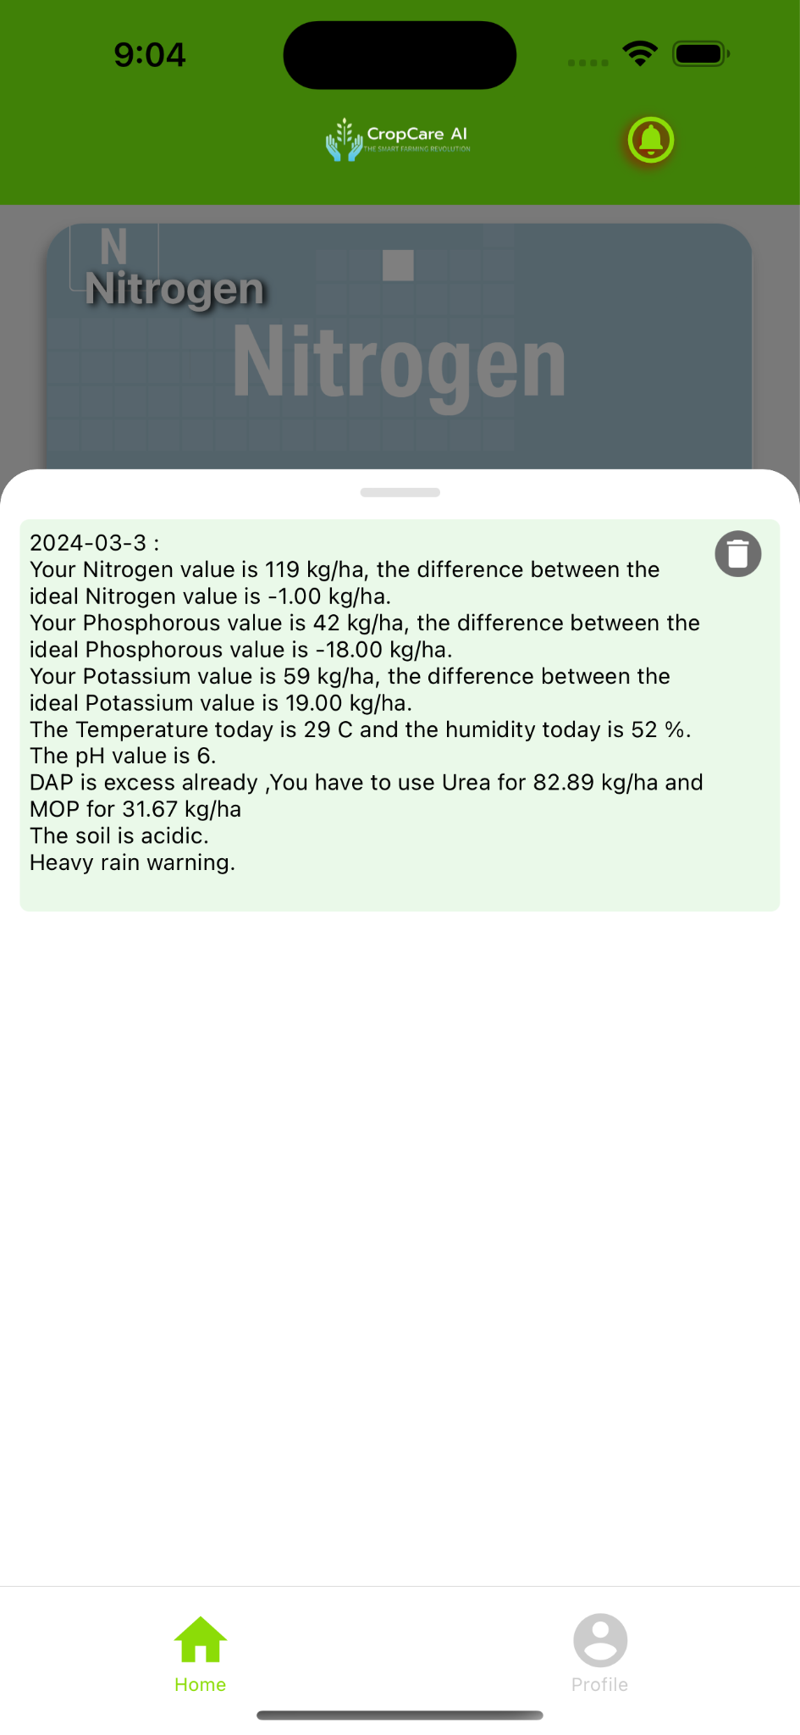
Predictions
Here is where we get all the predicted values from the database, here it selects the region. Then it runs the particular model for the region and then pushes the predicted value. Next the user has to confirm the crop. Then it goes to the daily work of saying the differences in NPK and temperature forecast. We have the optimal value of NPK for all the crops.
Fig 24. Predicted results

Slide 25
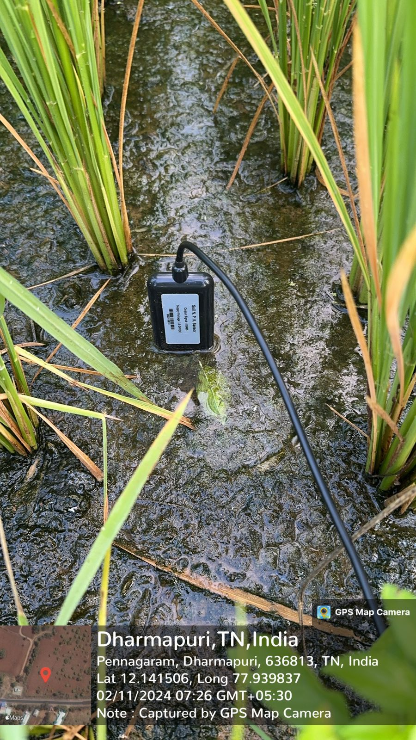
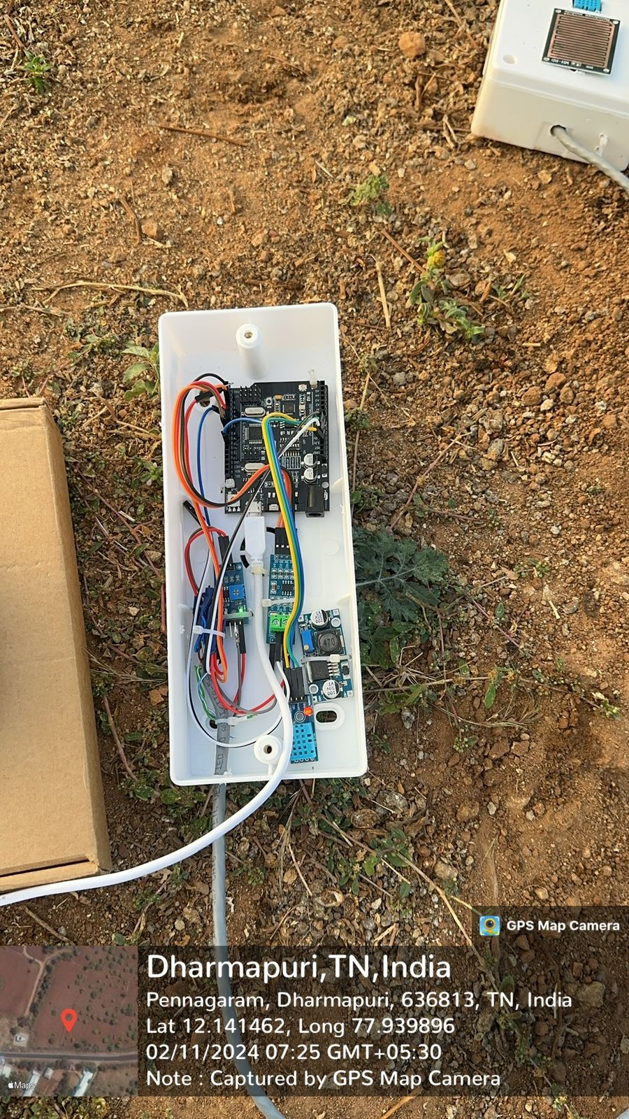
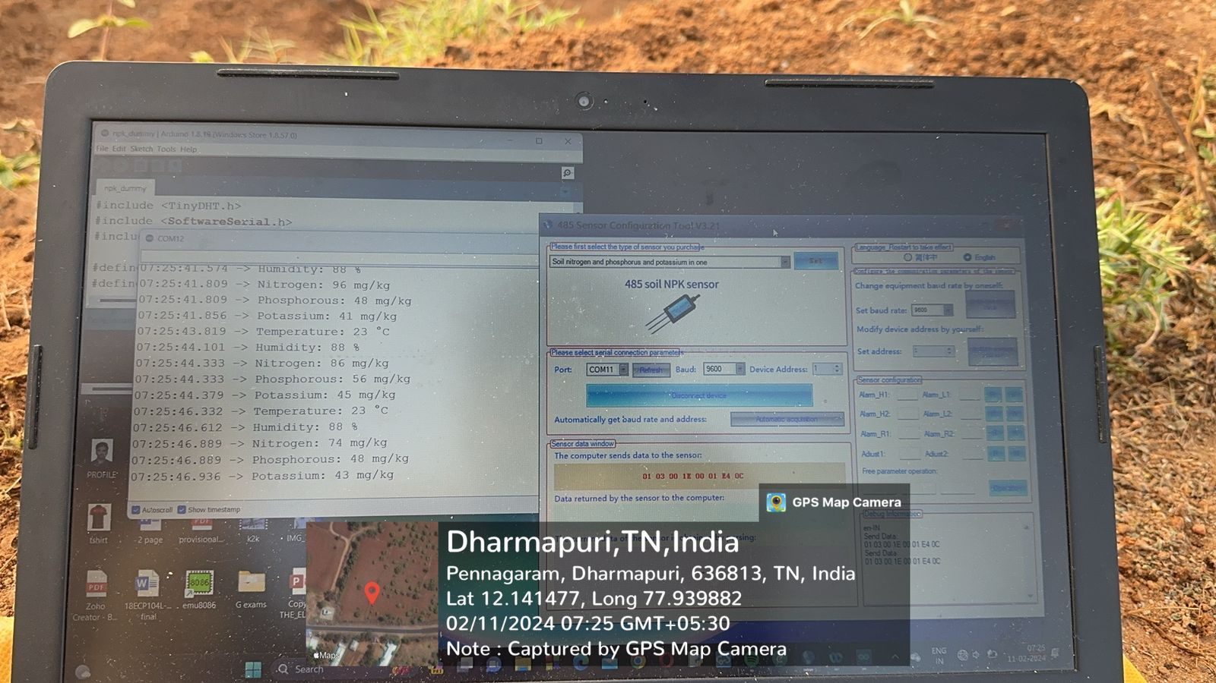
Hardware Components
Fig 25.NPK values monitoring
Fig 26. NPK sensor
Fig 27. Microcontroller

Slide 26
Logged Values from the sensor
07:24:30.963 -> Nitrogen: 75 kg/ha
07:24:30.963 -> Phosphorous: 46 kg/ha
07:24:30.963 -> Potassium: 35 kg/ha
07:24:33.494 -> Nitrogen: 72 kg/ha
07:24:33.494 -> Phosphorous: 47 kg/ha
07:24:33.494 -> Potassium: 38 kg/ha
07:24:36.021 -> Nitrogen: 71 kg/ha
07:24:36.021 -> Phosphorous: 59 kg/ha
07:24:36.068 -> Potassium: 44 kg/ha
07:24:38.545 -> Nitrogen: 86 kg/ha
07:24:38.545 -> Phosphorous: 53 kg/ha
07:24:38.591 -> Potassium: 41 kg/ha

Slide 27
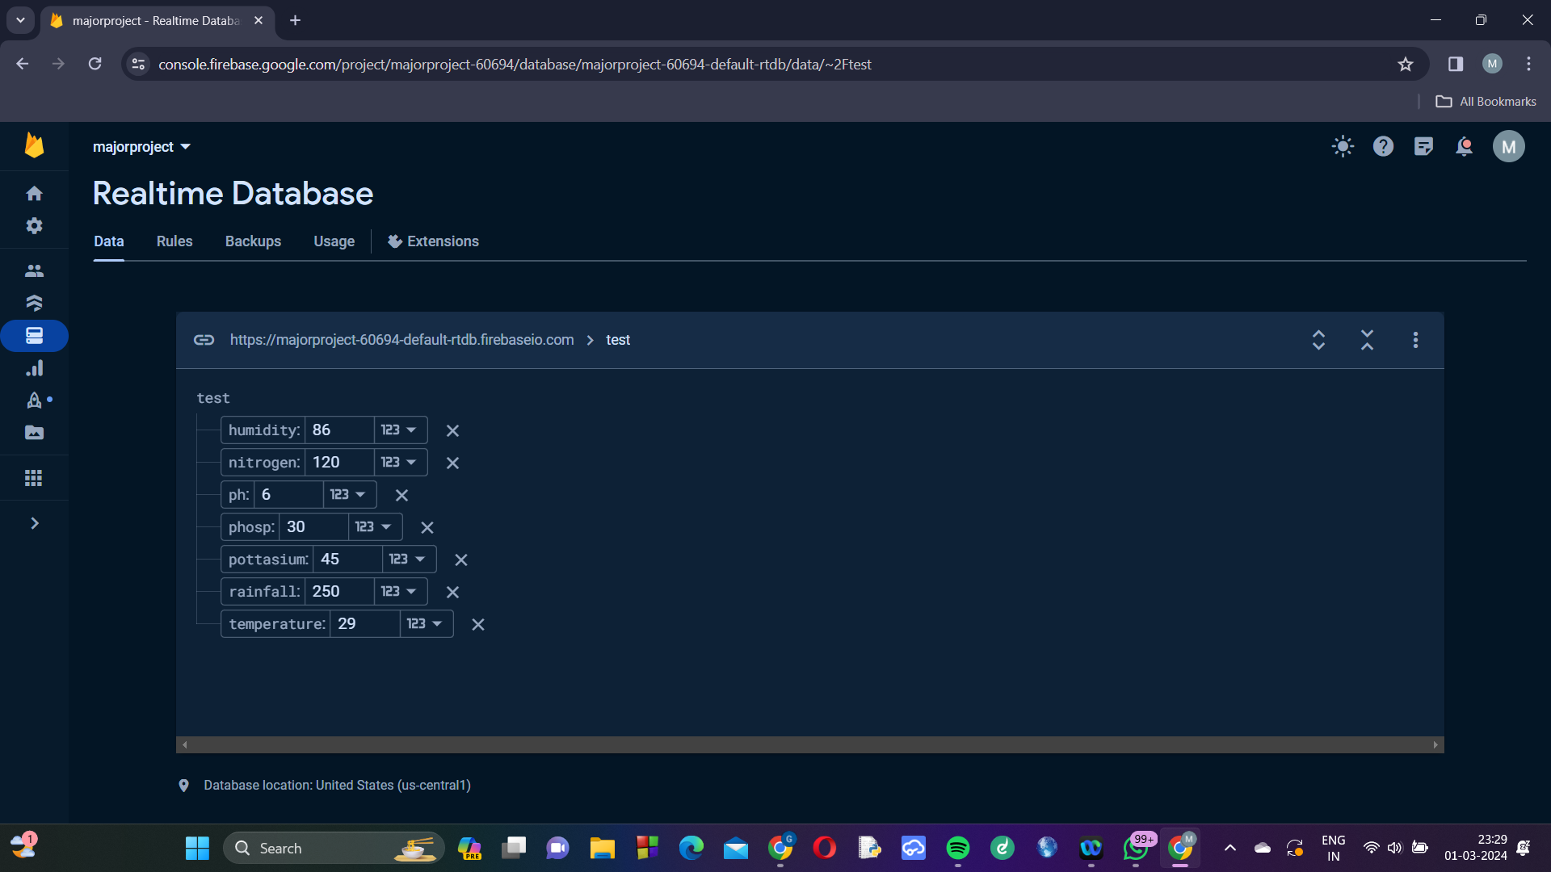
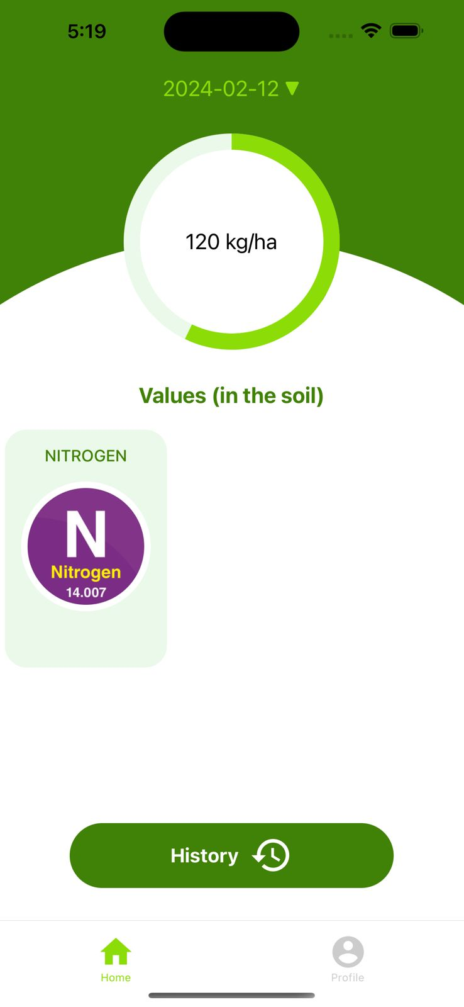
Data syncing from database to App :Nitrogen
Fig 29. NPK Page
Fig 28.NPK values monitoring

Slide 28
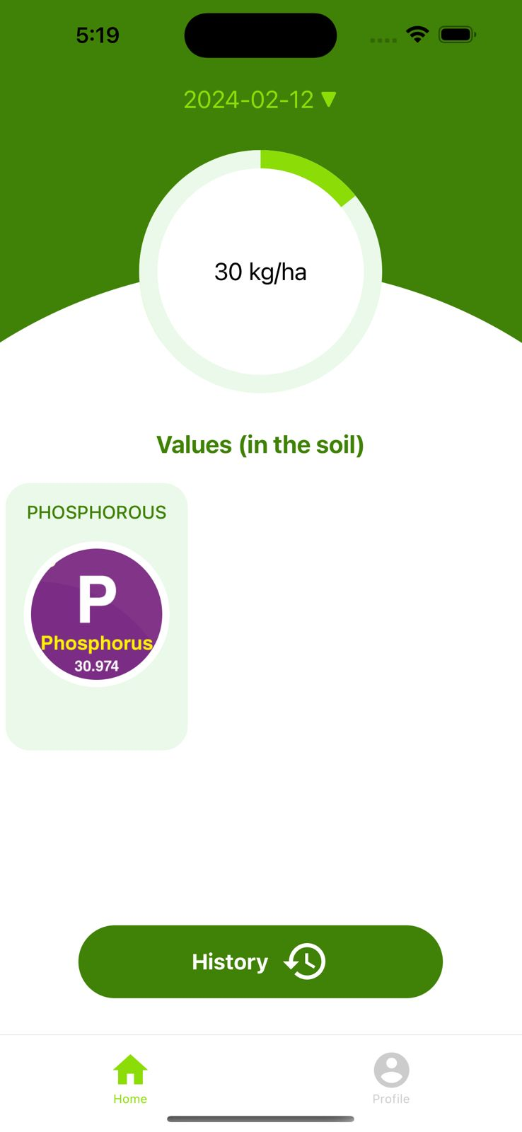
Data syncing from database to App :Phosphorous
Fig 31. NPK Page
Fig 30.NPK values monitoring

Slide 29
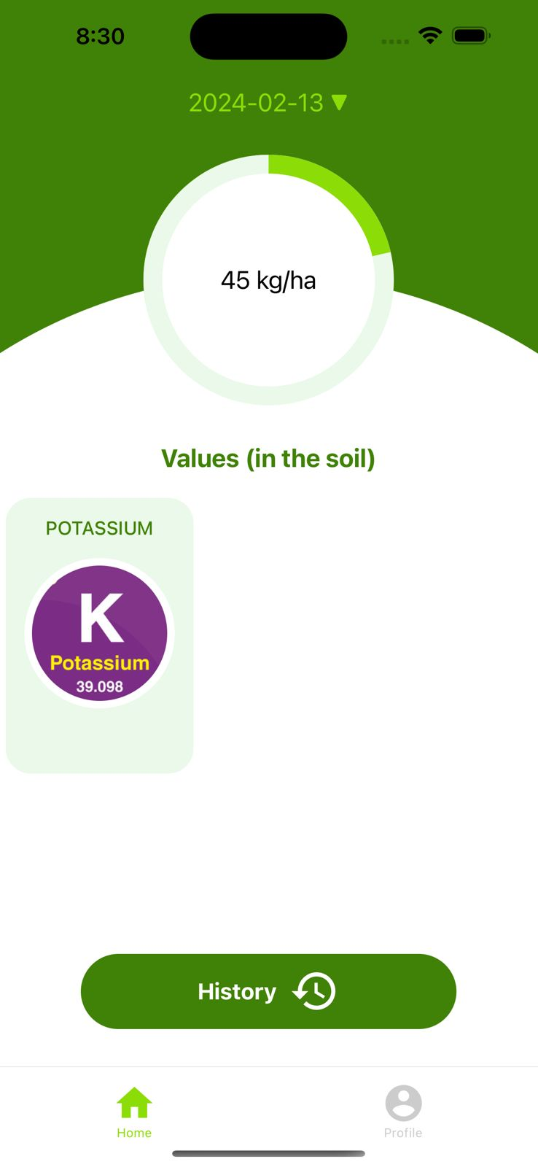
Data syncing from database to App :Potassium
Fig 32.NPK values monitoring
Fig 33. NPK Page

Slide 30
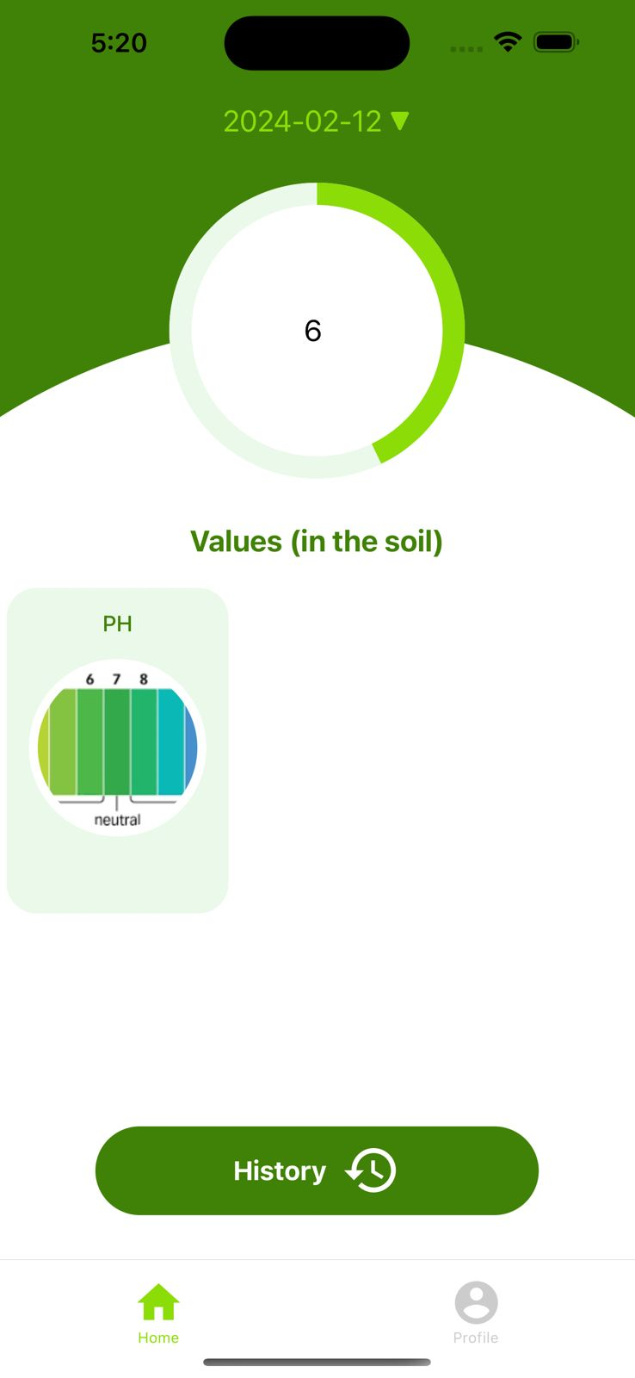
Data syncing from database to App :Ph value
Fig 35. Ph Page
Fig 34.Ph values monitoring

Slide 31
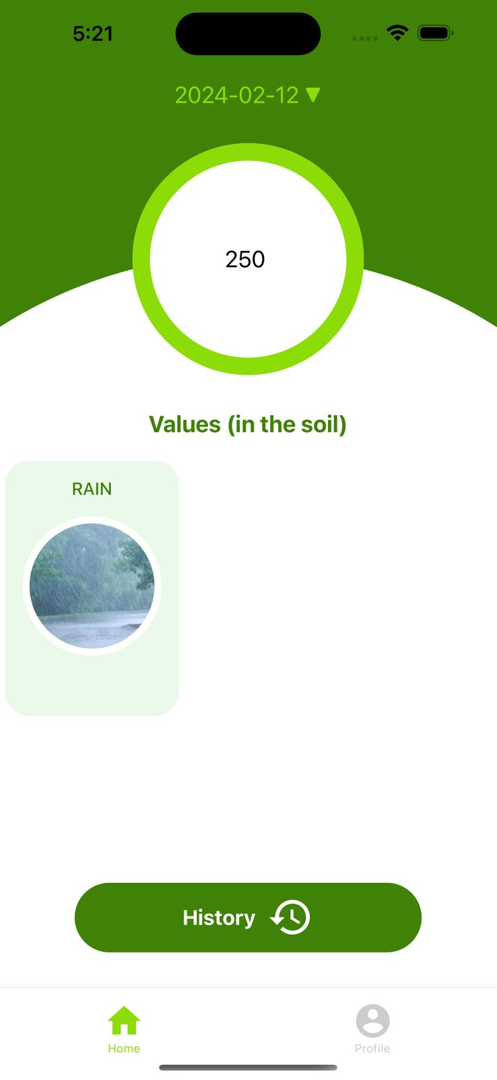
Data syncing from database to App :Rainfall
Fig 36.Rainfall values monitoring
Fig 37. Rainfall Page

Slide 32
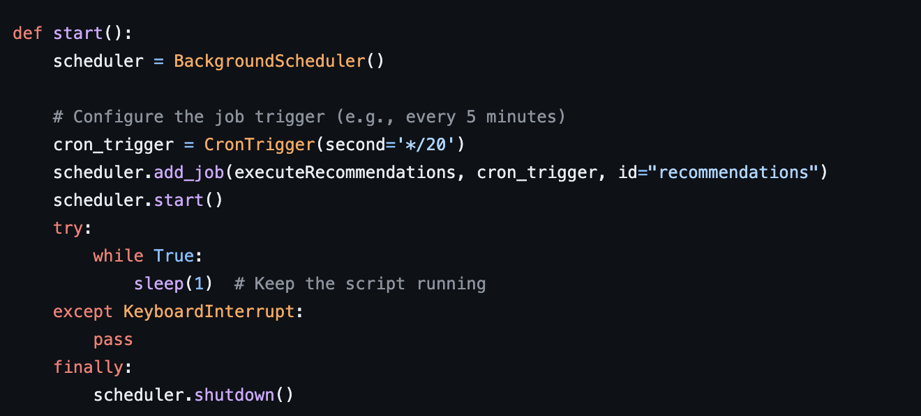
Cron job
Automated Task Scheduling: Cron jobs are used for automating repetitive tasks on Unix-like operating systems. They allow users to schedule commands or scripts to run periodically at fixed intervals, specified by the user. This automation is particularly useful for tasks like system maintenance, backups, log rotations, and other routine administrative functions.
Cron Tab Configuration: Cron jobs are managed through a configuration file called the "cron tab". Users can edit their cron tab to specify the schedule and the commands or scripts they want to run. The syntax for specifying the schedule can be quite flexible, allowing for precise timing.
Fig. 38. Cron Job

Slide 33
Engineering Standards
Security Standards:
Adherence to ISO/IEC 27001 for information security management.
Implementation of secure coding practices to mitigate vulnerabilities.
User Interface (UI) Design Standards:
Compliance with usability standards (e.g., ISO 9241) for user-friendly interfaces.
Accessibility standards (e.g., WCAG) for inclusivity.
Communication Protocols:
Use of standardized communication protocols (e.g., MQTT(Message Queuing Telemetry Transport)) for data exchange.
Compatibility with IoT communication standards
Data Privacy Standards:
Compliance with data protection regulations (e.g., GDPR(General Data Protection Regulation)).
Implementation of encryption and secure data transmission.

Slide 34
Realistic Constraints
Data Privacy and Security:
Adherence to privacy regulations.
Robust security measures for sensitive data.
Ethical Considerations:
Clear guidelines to prevent discrimination.
Ensuring unbiased behaviour.
Resource Limitations:
Consideration of hardware constraints.
Optimization for efficient resource use.
User Accessibility:
User-friendly interface for varying tech proficiency.
Compatibility with diverse devices.
Localization and Adaptability:
Tailoring to regional farming practices.
Adaptation to changing environmental conditions.
Cost Constraints:
Affordability for small-scale farmers.
Minimizing ongoing costs.

Slide 35
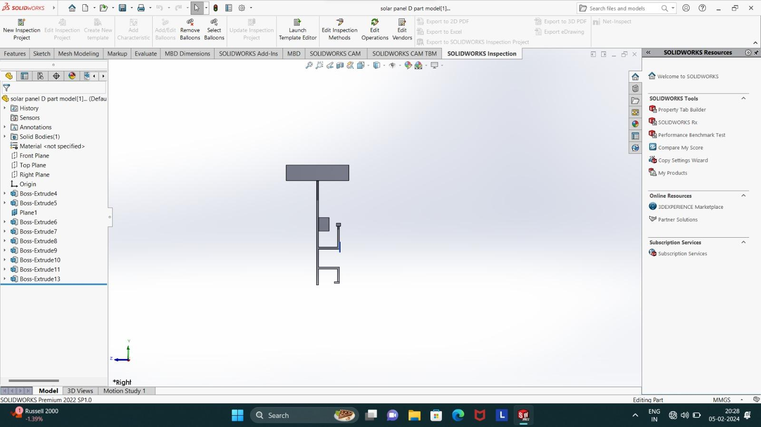
Prototype 3D model
Fig. 39. 3D model of the prototype

Slide 36
Results
We have created the fully functional User Interface with Backend running Machine learning Algorithms. We have created four different models for each regions. We have also created the API to get the data from Google’s Weather to get the Temperature, Humidity and Forecast. We have also used Cron job to trigger the loop of backend in the day at particular times.

Slide 37
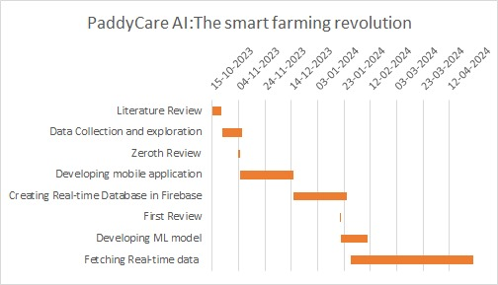
Time & Action Plan (Gantt Chart)

Slide 38
References
[1]Alfred, Rayner, Joe Henry Obit, Christie Pei-Yee Chin, Haviluddin Haviluddin, and Yuto Lim. "Towards paddy rice smart farming: a review on big data, machine learning, and rice production tasks." IEEE Access 9 (2021): 50358-50380.
[2]Sethy, Prabira Kumar, Santi Kumari Behera, Nithiyakanthan Kannan, Sridevi Narayanan, and Chanki Pandey. "Smart paddy field monitoring system using deep learning and IoT." Concurrent Engineering 29, no. 1 (2021): 16-24.
[3]Debnath, Oliva, and Himadri Nath Saha. "An IoT-based intelligent farming using CNN for early disease detection in rice paddy." Microprocessors and Microsystems 94 (2022): 104631.
[4]Bakthavatchalam, Kalaiselvi, Balaguru Karthik, Vijayan Thiruvengadam, Sriram Muthal, Deepa Jose, Ketan Kotecha, and Vijayakumar Varadarajan. "IoT framework for measurement and precision agriculture: predicting the crop using machine learning algorithms." Technologies 10, no. 1 (2022): 13.
[5]Joshua, Vinson, Selwin Mich Priyadharson, and Raju Kannadasan. "Exploration of machine learning approaches for paddy yield prediction in eastern part of Tamilnadu." Agronomy 11, no. 10 (2021): 2068.
[6] Rehman, Amjad, Tanzila Saba, Muhammad Kashif, Suliman Mohamed Fati, Saeed Ali Bahaj, and Huma Chaudhry. "A revisit of internet of things technologies for monitoring and control strategies in smart agriculture." Agronomy 12, no. 1 (2022): 127

